Slide 1
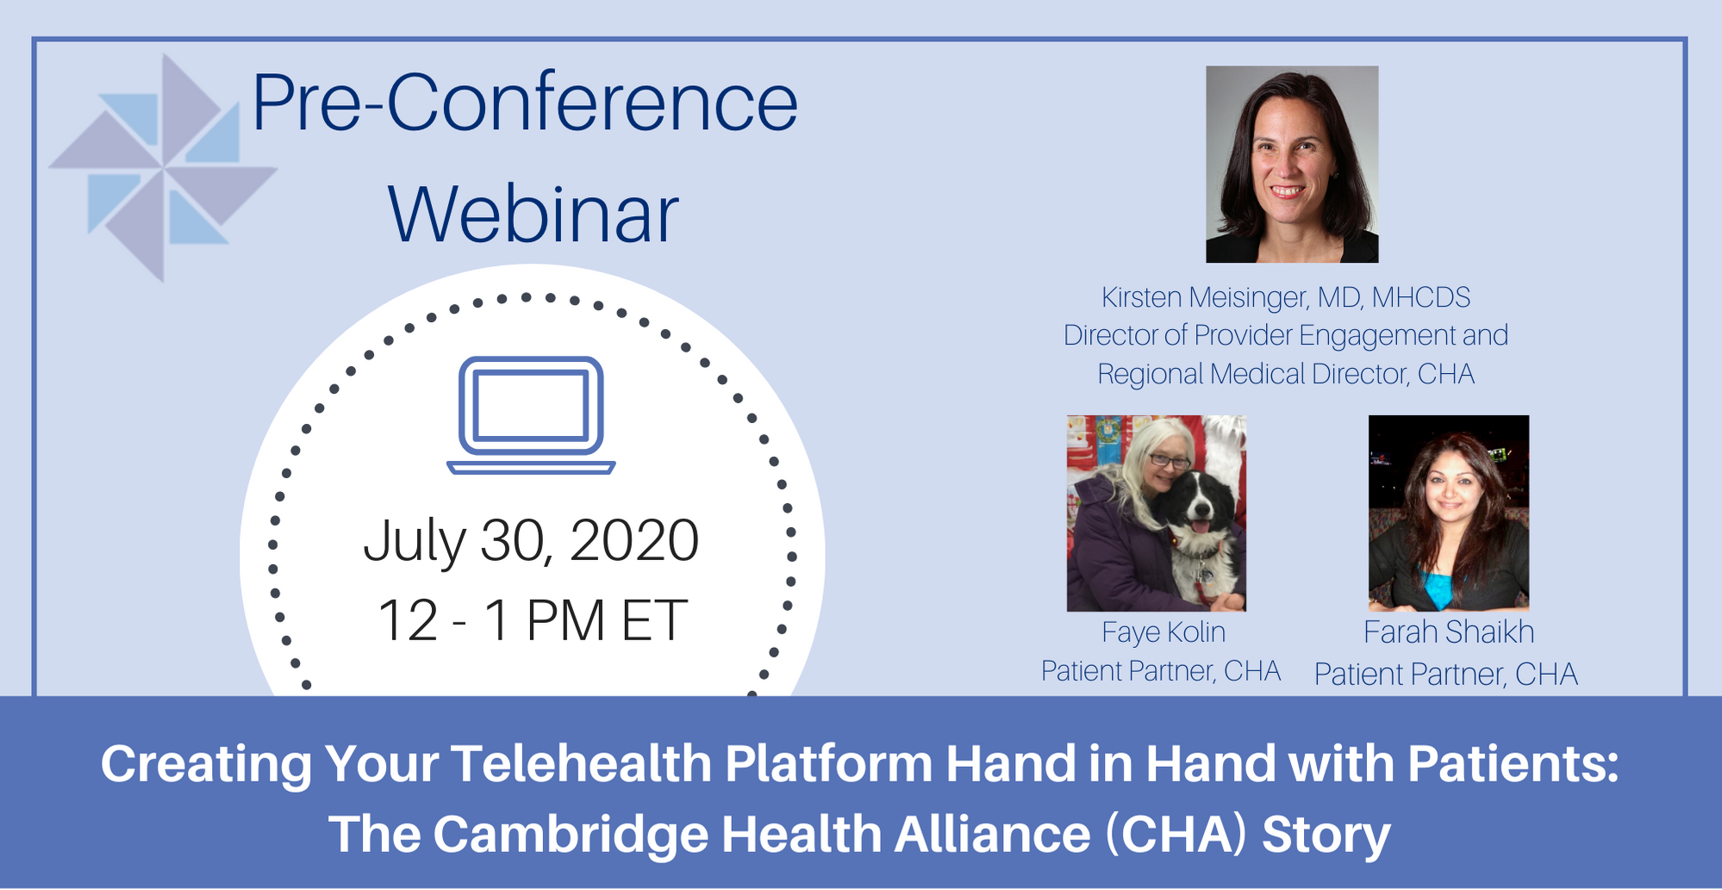
Notes:
Title with Line Under, Bulleted List

Slide 2
Helpful Tips
All participants will be muted upon entering
For optimal viewing, choose “Gallery View” in the top right hand corner of the Zoom window
Please post questions and comments in the chat box
A recording of this webinar will posted within 24 hours to IPFCC’s website.
Technical issues with Zoom – please call or text Natasha Reed at 646-789-1613

Slide 3
Notes:
Title with Line Under, Bulleted List

Slide 4
IPFCC’s Virtual Conference offers…
3-day kickoff from August 18-20 with plenaries and featured sessions
Interactive Poster Gallery
46 breakout sessions and weekly “ask an expert” sessions from August 25 – September 10
Over 60 posters
Nashville-themed surprises and prizes
Opportunities to connect with presenters and fellow attendees
For more information and to register today, visit:
www.ipfcc.org/events/conference.html

Slide 5
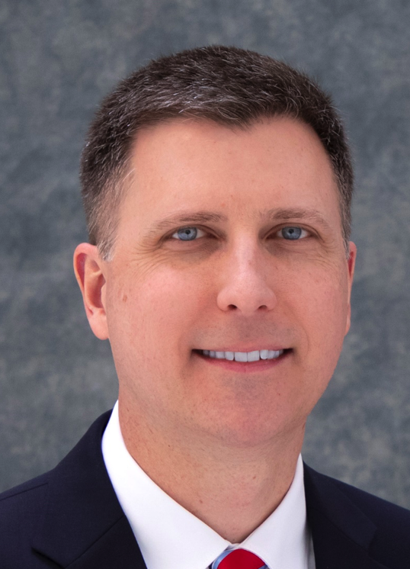
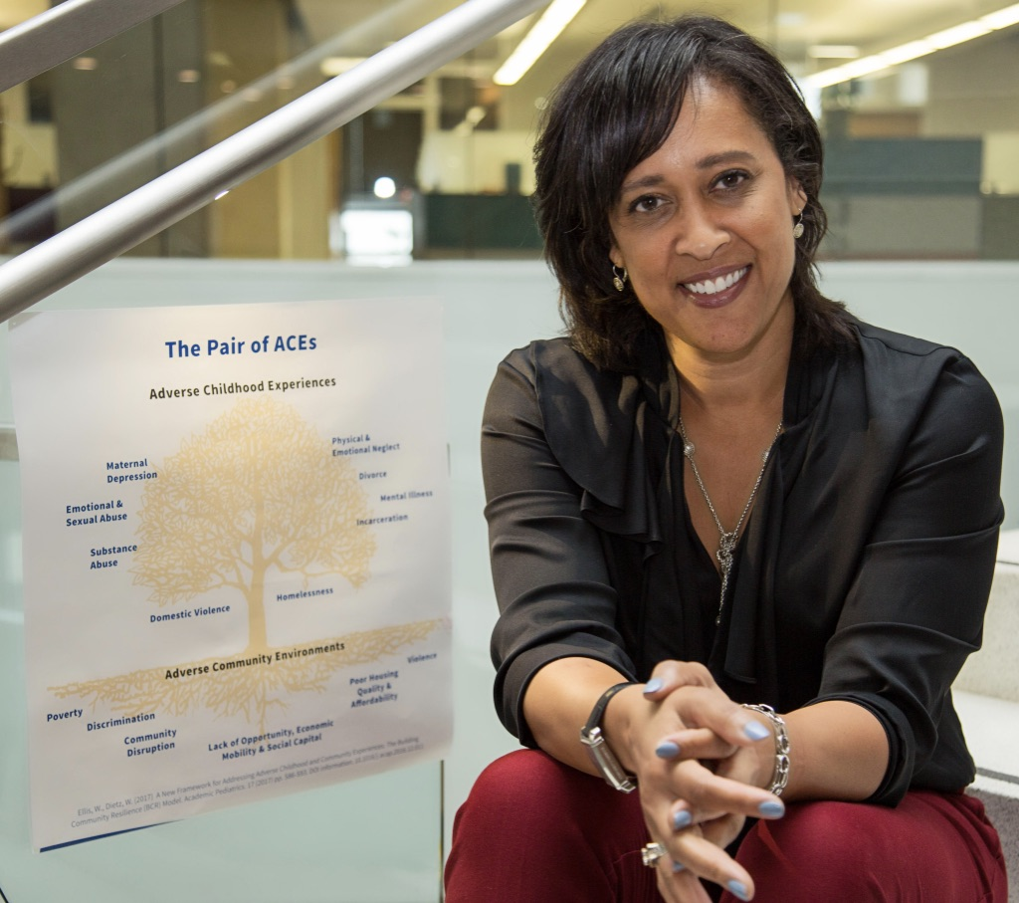
Highlights of the Virtual Conference
Building on today’s conversation:
Primary Care: New Opportunities for Enhancing Safety and Access
- Jeffrey Brady, MD, MPH
- Susan Edgman-Levitan, PA
Addressing Trauma, Fostering Equity, Building Community Resilience
Wendy Ellis, DrPH. MHP

Slide 6
Unique Features of the Virtual Conference
All sessions are recorded and accessible “on demand.”
FAQs for attending a virtual conference: www.ipfcc.org/events/conference.html
IPFCC conference in its virtual format means that sessions are available to use for leadership development or continuing education for staff, clinicians, and PFAs and Patient and Family Advisory Councils.
Virtual conference sessions can be used as the introduction of core partnership concepts and strategies for safety and QI teams.

Slide 7
Register to Win!
Bringing
To You
Goo Goo Clusters Gift Certificate
Loveless Café Biscuit Mix
Parnassus Books
Gift Certificate
Puckett’s BBQ Sauce
Kix Brooks’
“New to This Town” Album

Slide 8
Thank You to Our Sponsors

Slide 9
Special Thanks to . . .
IPFCC’s International Conference Ambulatory Programming is sponsored by:
https://petersonhealthcare.org

Slide 10
Creating Your Telehealth Platform Hand in Hand with Patients: The Cambridge Health Alliance Story

Slide 11
Co-creating Telehealth with
Patient Partners during COVID:
The Cambridge Health Alliance Journey

Slide 12
So, this happened...
Notes:
Kirsten

Slide 13
Friday March 13, 2020
It was 62 degrees F.
We were starting to see lots of people with upper respiratory symptoms, some with fevers
Windsor St. did the first televisit pilot from the clinic

Slide 14
Town Hall for Telehealth at CHA
or, WOW, a lot has changed in the past 3 weeks!

Slide 15
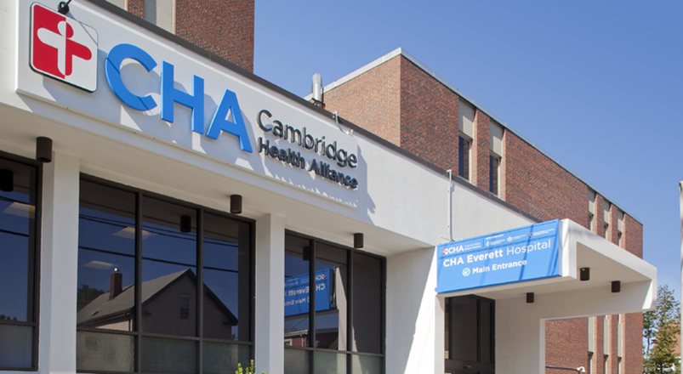
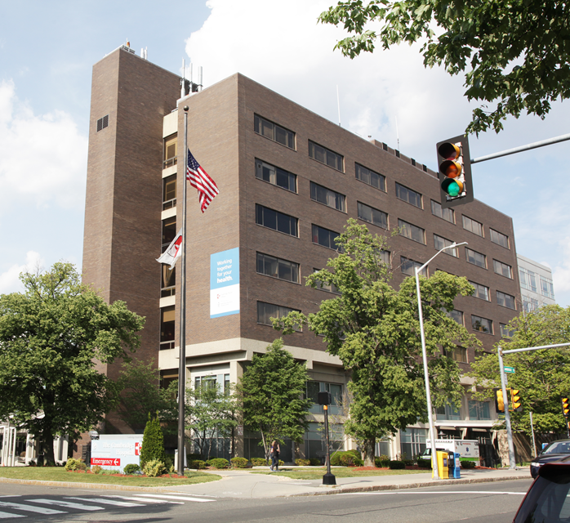
Cambridge Health Alliance (CHA) is a public safety net healthcare system north of Boston that serves 120,000+ patients in its primary care panels.
CHA has two acute care hospitals, 13 primary care practices, three school based health centers and a PACE program.
700,000 annual outpatient visits, including emergency and BH, and 10,000 hospitalizations (medical, surgical, psychiatric, obstetric, newborn care)

Slide 16
TELEVISITS
Goal – Reduce the risk of COVID-19 infection by providing as many visits as possible as a virtual “visit” by phone. These “TELEVISIT” encounters are designed to mimic, as much as possible, office visits
Key features of the new process:
Patients calling for new appointments are defaulted to TELEVISITS using new guidance and protocols (in addition to usual triage processes)
NO in person visit possible unless televisit done first
For patients with symptoms, route to respiratory call center
Staff and providers use the new visit type called “TELEVISIT” in scheduling and documentation

Slide 17
Faye Kolin — longtime CHA patient and member of the CHA’s Innovation team
Participation in the Center for Mindfulness and Compassion online programming
Watching the changes on CHA Facebook
Reactions to communications about how to get care and stay safe
Notes:
Faye

Slide 18
Farah Shaikh
Experience of care for herself and family (parents, grandparents and kids!) during the pandemic
Video vs telephone
Notes:
Farah

Slide 19
Mobilizing Healthcare For A Digital World
In response to Covid 19, CHA is working with Google and Epic to enable you to serve and connect with your patients despite physical distance.
https://www.youtube.com/watch?v=Hk5SE6ht0Pc&feature=youtu.be
Notes:
Kirsten

Slide 20
How to Navigate Google Meet
step by step instructions for patients and providers

Slide 21
How we work together
Patient Digital Engagement Committee
Charter:
PDEC Vision: The Patient Digital Engagement Committee will focus efforts on what patients value from digital connectivity and around their wants and needs. It will help patients optimize their digital experience and their health.
PDEC Mission: Patient Digital Engagement will focus services to meet patient needs in real time and create an easy and user-friendly patient virtual experience.
Patient Partners from the start, now 2 partner voices on each sub-committee as well
Meet monthly with report outs by sub-committees on the work progress
Each meeting starts with a word from our patient partners and a review of the previous meeting’s survey results

Slide 22
Farah and Faye’s work on the committee
Experience of being patient partners in this work

Slide 23
Conclusions and Questions
This work is neither complicated nor difficult
You too can do this!
Be the champion in your system

Slide 24
Giveaway Prize
Kix Brooks, Board Chair for the Monroe Carell, Jr. Children’s Hospital at Vanderbilt
Register for both the webinar and Conference for a chance to win Kix Brooks “New to This Town” album!
Register for Conference

Slide 25
Please complete this short survey:
https://www.surveymonkey.com/r/FQQPGKZ

