Slide 1
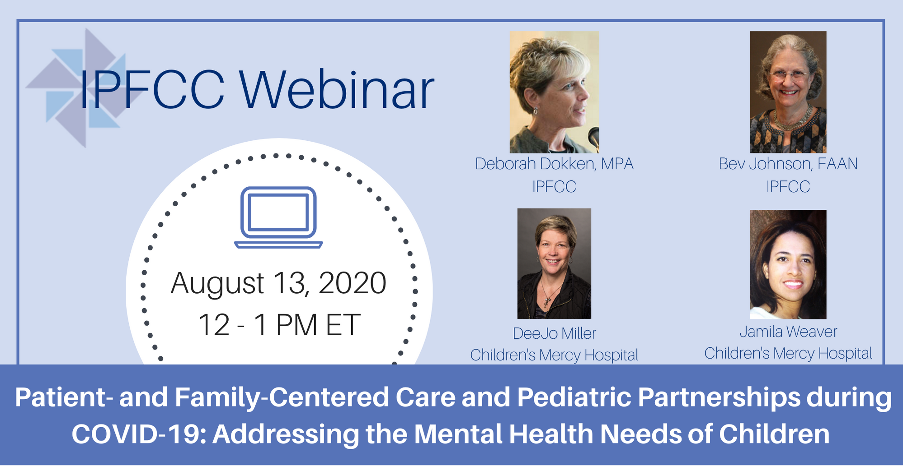

Slide 2
Helpful Tips:
To download handouts – see link in chat
All participants will be muted upon entering
Please do not use the Q&A function for questions, enter all questions into the chat box
If you are experiencing technical difficulties, please text Natasha Reed at 646-789-1613 for immediate assistance.
If there are technical difficulties due to the high volume of Zoom usage, we will record and post this webinar within 24 hours to IPFCC’s website.

Slide 4
Children are not the face of this pandemic. But they risk being among its biggest victims. While they have thankfully been largely spared from the direct health effects of COVID-19 – at least to date – the crisis is having a profound effect on their wellbeing.
United Nations, April 2020

Slide 5

Patient- and Family-Centered Care and Pediatric Partnerships During COVID-19
Funded by:

Slide 6
In our time together . . .
Discuss how PFCC, including its emphasis on partnerships, can continue to be the framework for providing care to children, youth, and their families during COVID-19
Summarize the impact of the pandemic on children and their mental health care needs
Share the experience of pediatric hospitals in adapting services to meet the needs of children and their families during COVID-19
Notes:
Title with Line Under, Bulleted List

Slide 8
Patient- and Family-Centered Care
Core Concepts
People are treated with dignity and respect.
Health care providers communicate and share complete and unbiased information with patients and families in ways that are affirming and useful.
Patients and families are encouraged and supported in participating in care and decision-making at the level they choose.
Collaboration among patients, families, and providers occurs in policy and program development, QI and safety, professional education, and research as well as in the delivery of care.
Notes:
Title with Line Under, Bulleted List

Slide 9
Patient- and Family-Centered Authentic Partnerships
Working "with" patients and families, rather than just doing "to" or "for" them.
Family presence and participation
Involvement of Advisory Councils and patient/family advisors
Notes:
Title with Line Under, Bulleted List

Slide 10
Impact of Closed Schools
The harms attributed to closed schools on the social, emotional, and behavioral health, economic well-being, and academic achievement of children, in both the short- and long-term are well-known and significant. Further, the lack of in-person educational options disproportionately harms low-income and minority children and those living with disabilities.
AAP, American Federation of Teachers, National Education Association, School Superintendents Association, June 2020

Slide 11
For those experiencing mental or behavioral health challenges, this has been an especially difficult time. As if fear of contracting the virus weren’t enough, the need for social distancing . . . and complete disruption of one’s day-to-day activity only compounds the impact. Now, maybe more than ever, these individuals need access to behavioral health services.
NEJM Catalyst, 2020

Slide 12
What Children Are Being Impacted?
Children with prior mental/behavioral health conditions (approximately 15 million, AAP)
Children with chronic health conditions, disabilities, & special health care needs
All children, all ages
Notes:
Title with Line Under, Bulleted List

Slide 13
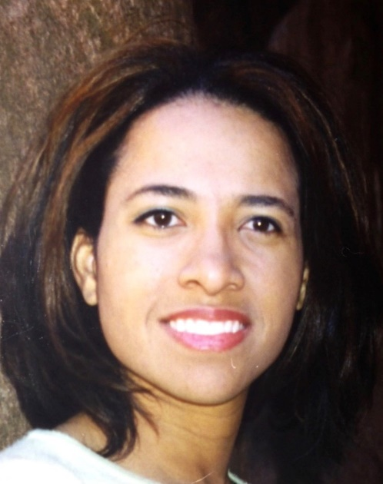
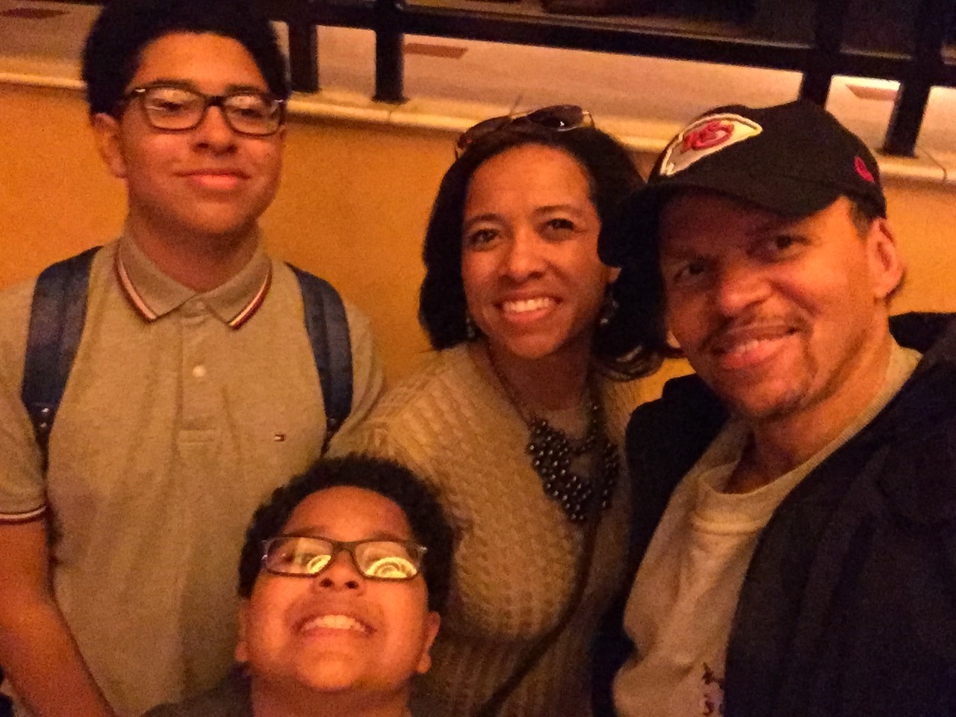
Jamila Weaver
Parent Chair
Mental Health PFAC

Slide 14
Patient & Family Engagement
PFCC
Policy
Instances of PFAs on committees and projects per year

Slide 15
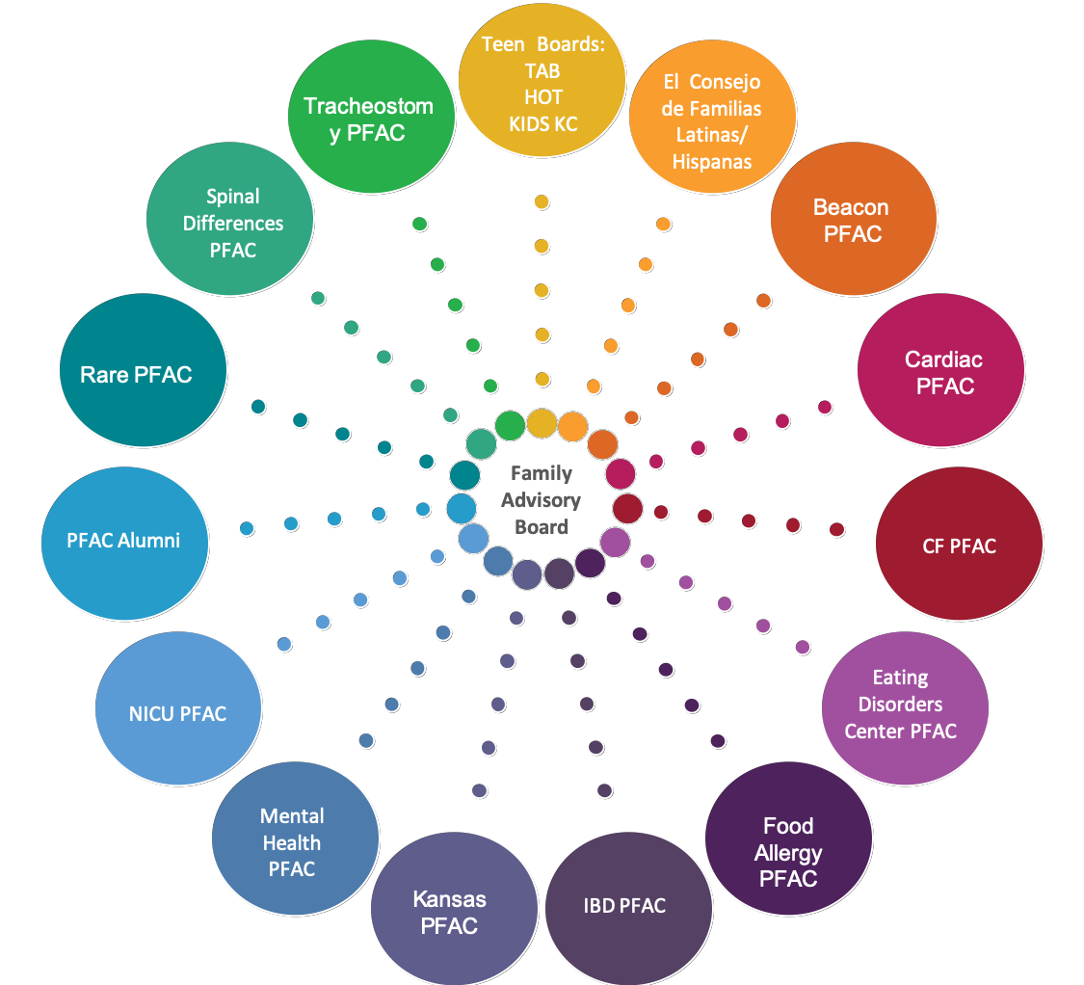
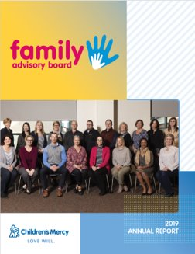
Patient Family
Advisory Councils

Slide 16
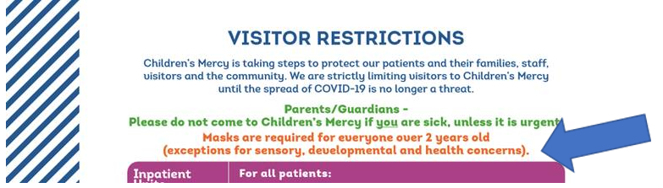
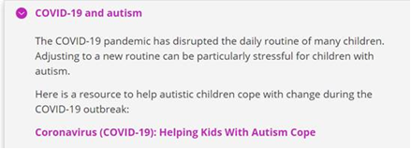
PFAC Collaboration during COVID-19
Website information
  What to expect when they come back
  Guide about safely resuming activities
  How to help their child wear a mask
Information for staff
“My child can’t wear a mask because of his sensory issues.”
Telehealth
  Developmental & Behavioral appointments went 100% virtual immediately
  Information is shared on the website to help families with their telehealth visit
  We also continue to strive to complete suicide screenings via telehealth.
Diagnosis specific information
16

Slide 17


Family Advisory Board, created 10 years ago, includes parents and youth as members.

Slide 18

Pediatric Behavioral Health and Wellness Outpatient Services is convening a series of Community Conversations related to COVID-19.
A new Family Advisory Group created to assist in planning additional COVID-19 Community Conversations through a local grant. Intentionally recruited for the diversity of families.
Both the Family Advisory Board and the Family Advisory Group are involved in the planning of the COVID-19 Community Conversations.
Notes:
Title (No Line Under), Bulleted List (Tab in bullet to go to lower bullet level.)

Slide 19

Psychiatry
Family Advisory Board
Has grown significantly in the last three years — 16 members
Supports all psychiatric services: Inpatient, Ambulatory Programs, and Psych Emergency Department
Has met virtually on a monthly basis since March
Open Forum supports “real time” parent input in each meeting
Currently parents are embedded in key committees:
  Psychiatry Leadership Committee
  Equity Taskforce
  Specific Improvement Work Committees
Parents provide Mental Health First Aid training to school districts
Planning to expand parent collaboration about COVID-19 issues with school districts

Slide 20

www.seattlechildrens.org/health-safety/keeping-kids-healthy/development /supporting-mental-wellness-and-family-life-during-covid-19/

Slide 21

Family Advisory Council
Before COVID, telehealth used mainly for psychology and psychiatry services; now used broadly, even for PT, OT, and RT
FAC worked on a listing of the benefits of telehealth to share with other families and helped develop guidance to prepare families for telehealth visits
Because of impact of sheltering-in-place, FAC developed a Tip Sheet (on the website) to help families manage challenging behaviors in children

Slide 22
Family Advisory Council
“Sometimes we need to cry as a council.”
Donna Provenzano
Director of Family-Centered Care
Supporting the emotional well-being of Family Advisory Council members is another priority. Many family advisors have had personal challenges during the COVID-19 Pandemic.

Slide 23
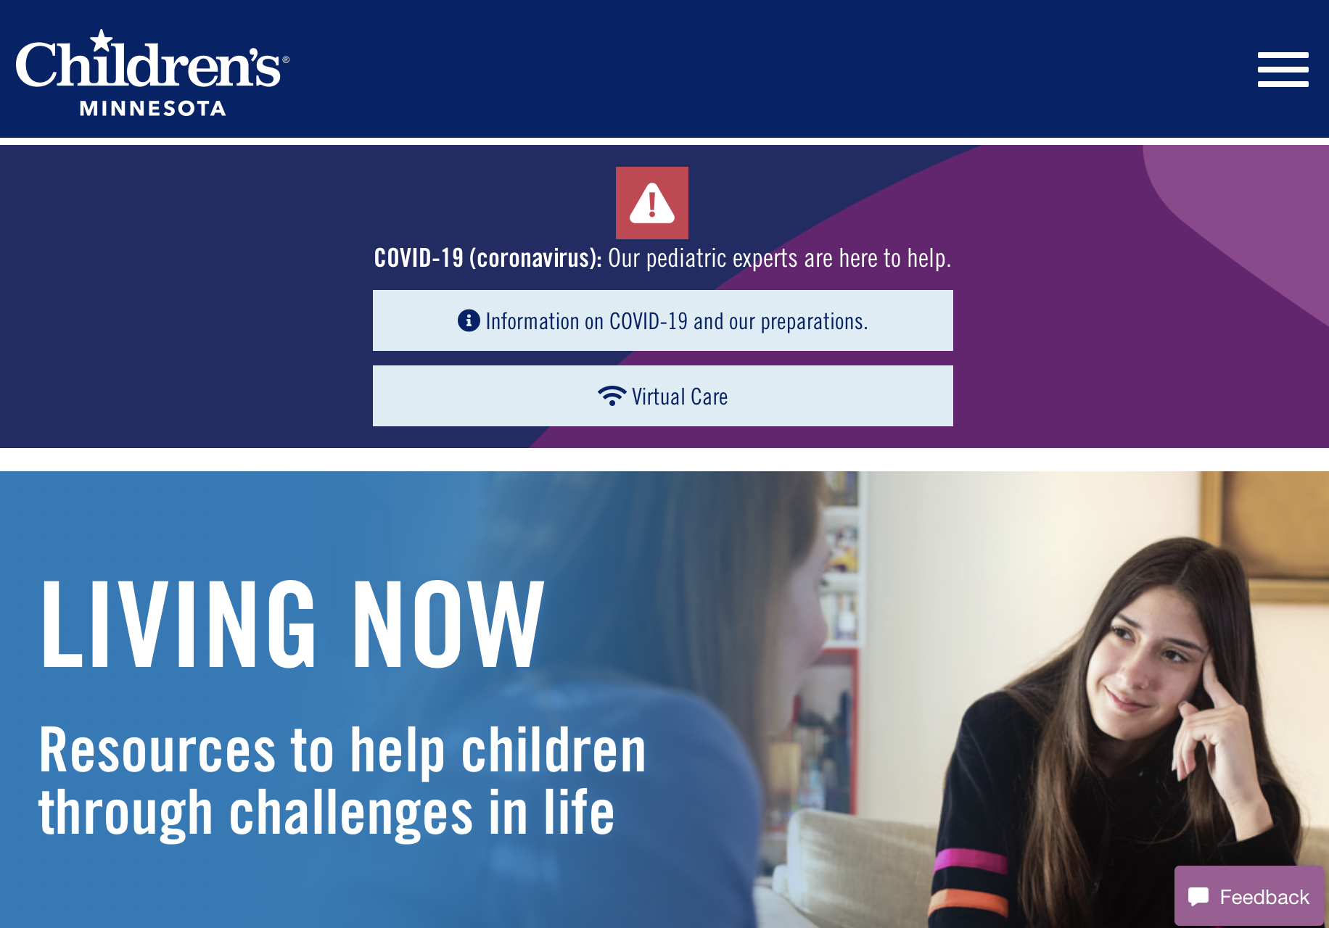

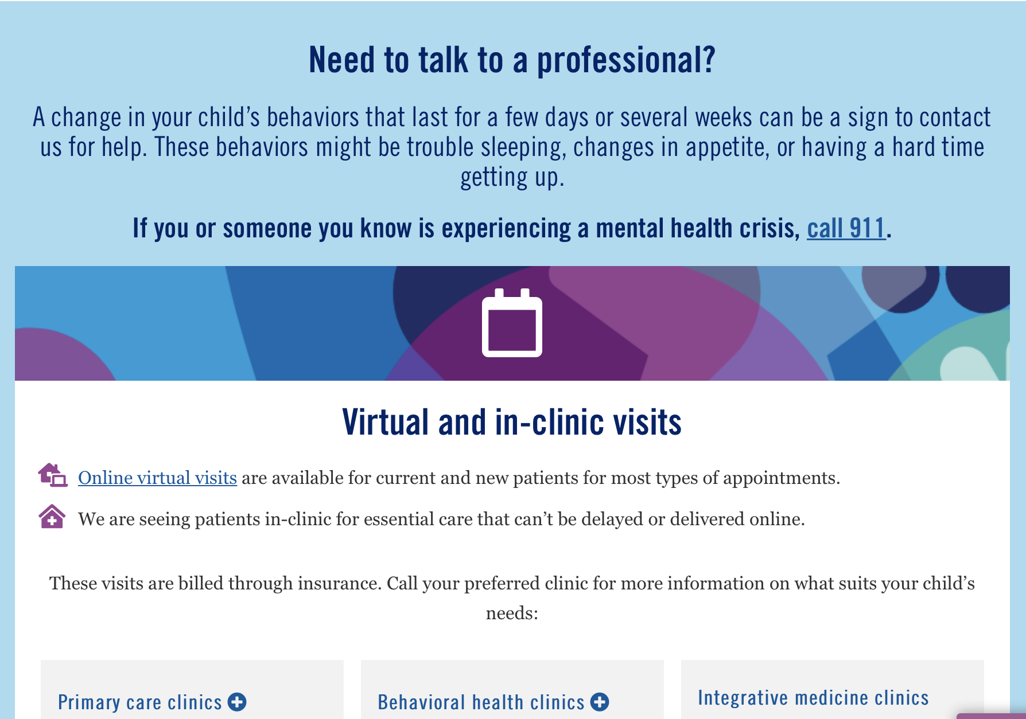
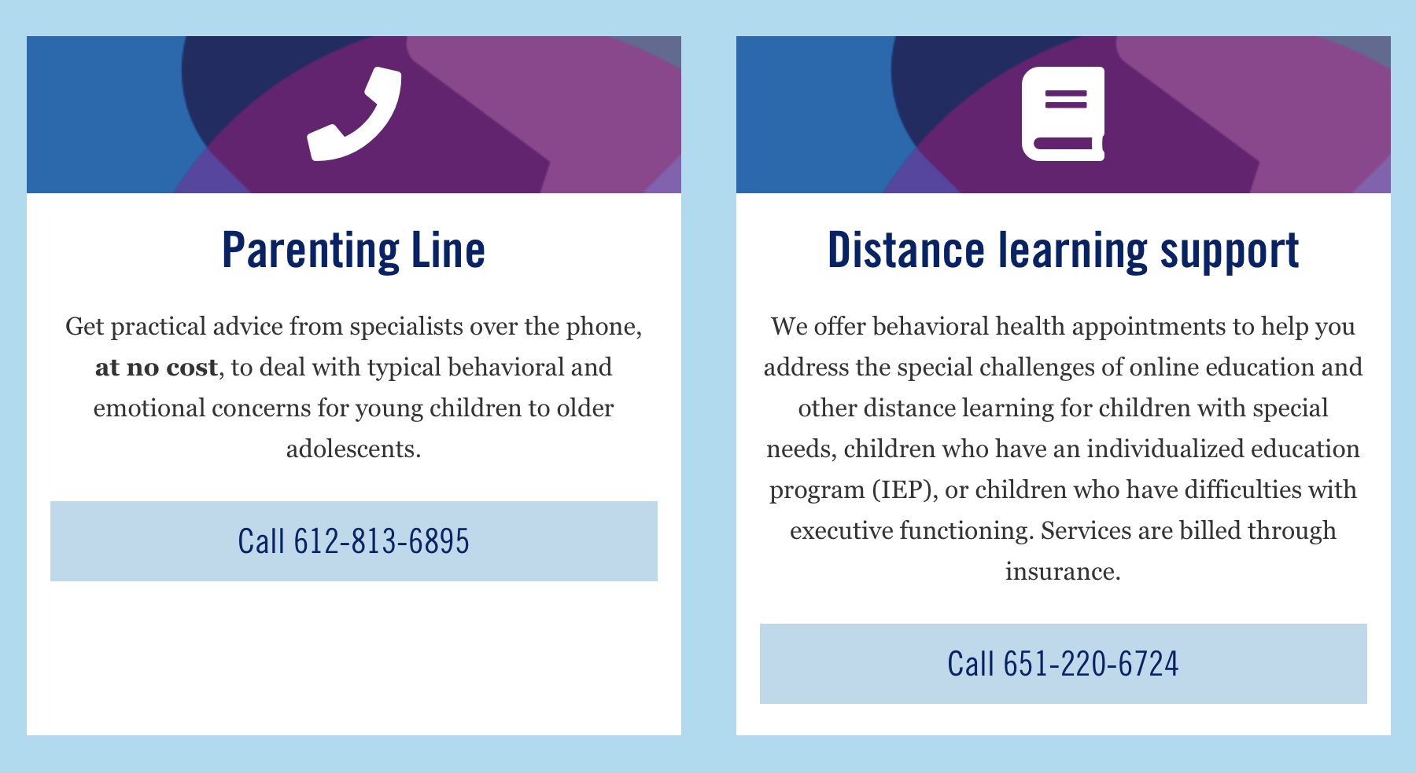
A Variety of Mental Health Resources
www.childrensmn.org/behavioral-support-hub/

Slide 24
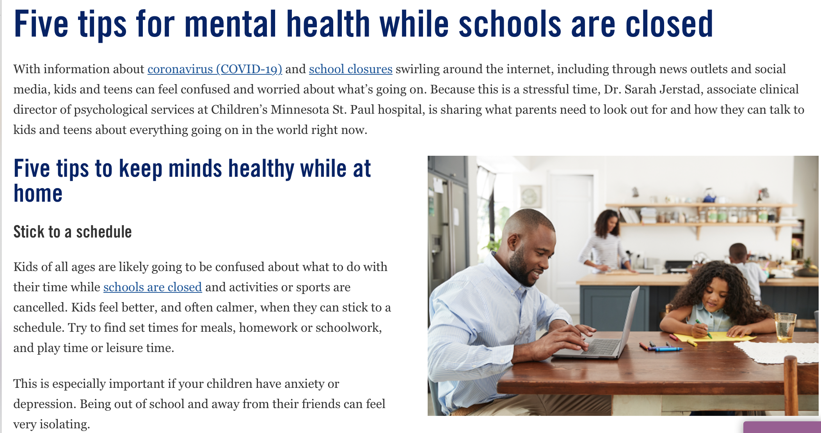
Stick to a schedule
Stay calm
Limit screen time
Give kids facts
Reach out for help
www.childrensmn.org/2020/03/18/five-tips-mental-health-schools-closed/

Slide 25
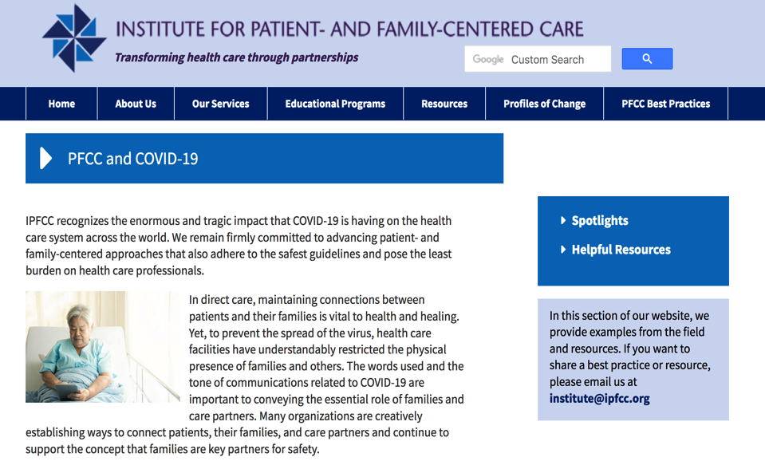
https://www.ipfcc.org/bestpractices/covid-19/index.html

Slide 26
Free Opportunities to Learn More and Share Emerging COVID Best Practices
Informal Conversation on PFCC.Connect
  Tuesday, September 29th, noon ET
  Recordings available for past and future Conversations in Library for PFCC.Connect
Webinar
  Thursday, October 29th, noon ET
  Recordings available for current and future webinar at: www.ipfcc.org/events/webinar-recordings.html

Slide 27
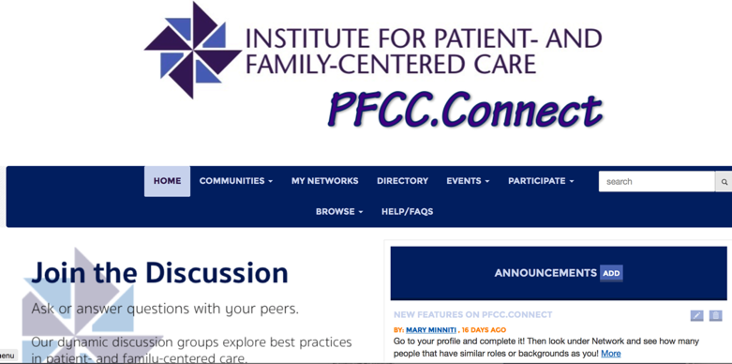
A free online learning community dedicated to partnerships with patients and families to improve and transform care across all settings.
http://pfcc.connect.ipfcc.org/home

Slide 28




IPFCC’s Virtual Conference offers…
3-day kickoff from August 18-20 with plenaries and featured sessions
Interactive Poster Gallery with over 60 posters
46 breakout sessions and weekly “ask an expert” sessions from August 25 – September 10
Nashville-themed surprises and prizes
Opportunities to connect with presenters and fellow attendees
For more information and to register today, visit:
www.ipfcc.org/events/conference.html

Slide 29




Scholarships Still Available…
For New York State Residents:
  No cost scholarships
  Apply:
  https://www.surveymonkey.com/r/NYSHF_IPFCC_Conference_Scholarship_App
Matching Scholarships:
  Available to anyone, in any location
  50% match = $250 for health care professionals; $200 for patient family advisors
  Apply:
  https://www.surveymonkey.com/r/Partial_Conf_Scholarships

Slide 30
Q&A

Slide 31
Thank You for Joining Us!
Please fill out the survey on your experience today:
www.surveymonkey.com/r/Pediatric_
Mental_Health_Webinar_Aug20
Bev Johnson
bjohnson@ipfcc.org
Deborah Dokken
ddokken@ipfcc.org

